Slide 1
BIOM262 RNA processing
1/26/16

Slide 2
Outline
Sequencing Technology overview
Basic structure
Which technology do I want for my task?
Overview of RNA-seq
General analysis concepts
Profiling gene expression and alternative splicing
Other uses of high-throughput sequencing
CLIP/RIP-seq: identifying protein binding sites
Ribosome profiling: quantification of translation
Others (RNA modifications, structure)
Public resources & large-scale data resources

Slide 3
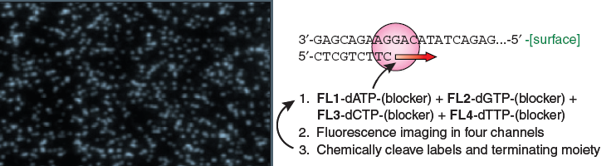
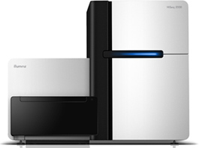
Sequencing by synthesis: HiSeq 2500 (Illumina)
Shendure & Lee, Nat. Biotech. 2008
Can do 50bp to 250bp single-end or paired-end reads
~300 million reads per lane x (2 or 8) lanes
4-8 days run time
200 billion bp output each run
Notes:
3

Slide 4
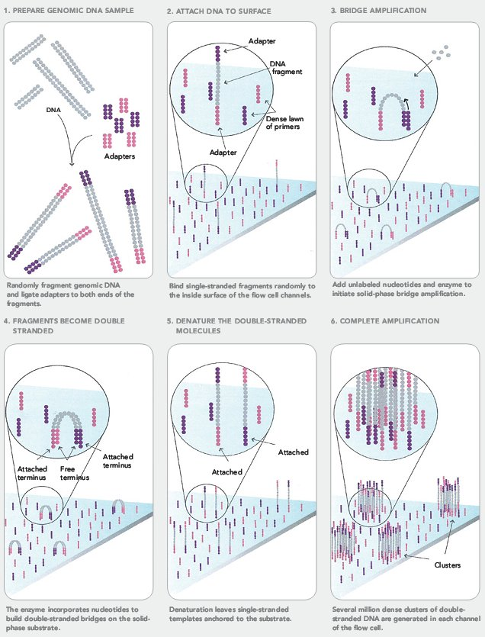
Cluster Formation on Illumina Flowcell

Slide 5
Reversible Terminator Chemistry
O
O
X
5’
HN
cleavage
site
HN
fluor
DNA
O
N
O
N
PPP
O
O
O
Incorporation
Detection
Deblock; fluor removal
3’
3’
block
OH
free 3’ end
Next cycle

Slide 6
Sequencing by Synthesis
3’-
…-5’
5’-
G
T
A
T
T
T
T
C
G
G
C
A
C
A
G
A
G
A
C
T
T
C
T
G
Cycle 1: Add sequencing reagents
First base incorporated
Remove unincorporated bases
Detect signal
Cycle 2-n: Add sequencing reagents and repeat

Slide 7
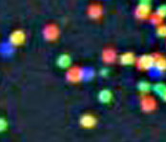
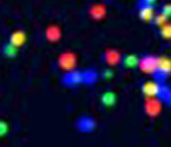
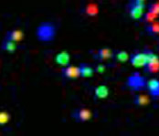
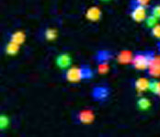
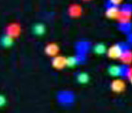
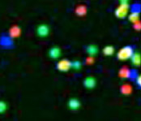
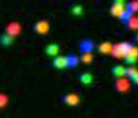

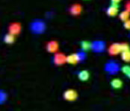
Sequential Base Calling
T G C T A C G A T …
1
2
3
4
5
6
7
8
9
T T T T T T T G T …

Slide 8
Illumina sequencing – fragment strategy
I5 adapter
Read1 primer
DNA insert (your library)
Read2* primer
I7 adapter
Flow Cell Surface
I5 index*
I7 index*
* optional
Reaction #
Flow Cell Surface
1
Read1 primer
Read1 sequence
Flow Cell Surface
2*
Index1 primer
Index1 sequence

Slide 9
Illumina sequencing – Paired End & Dual Indexing
Reaction #
Flow Cell Surface
1
Read1 primer
Read1 sequence
Flow Cell Surface
2*
Index1 primer
Index1
(I7) sequence
Flow Cell Surface
3*
Index2 primer
Index2
(I5) sequence
Flow Cell Surface
4*
Read2 primer
Read2
sequence
* optional

Slide 10
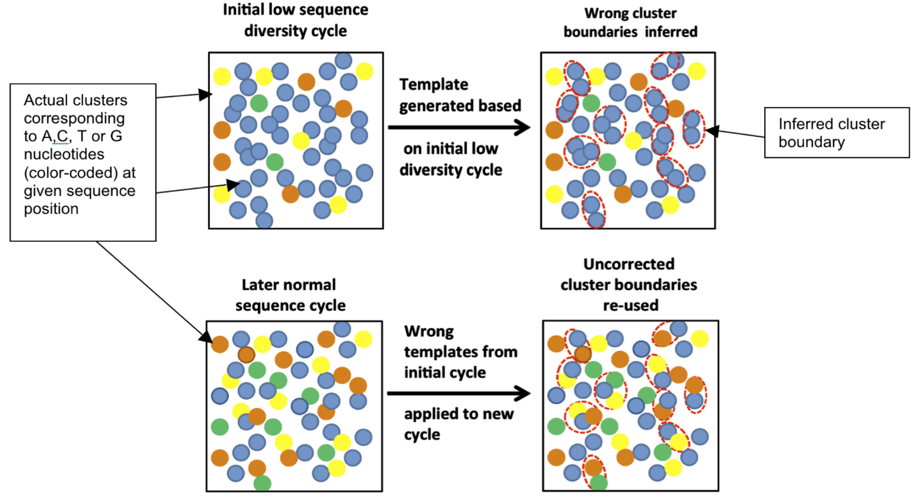
Key considerations
“Cluster Density” = how many clusters are there per mm²
If too high, hard to properly draw cluster boundaries
“Library Complexity” = how diverse are the sequences?
Illumina identifies clusters in the first 5 cycles – if those 5 cycles are identical for nearby clusters, the software doesn’t know to split them into two
Mitra, A. et al. Plos ONE (2015)

Slide 11
Key considerations
How can you solve a problem like this?
Decrease cluster density – works, but lose sequencing power
Artificially add complexity
Spike in other libraries
Add random-mers
Instead of this:
Read1 primer
Read1 sequence
NNN
Add diversity to adapters:
NN
N
Key to sequencing – how to hack the standard fragment strategy to get the desired results

Slide 12
HiSeq 4000
Patterned flow cell with nanowells
Only 1 cluster per nanowell
Explicitly defines cluster density
Increased throughput:
400 million reads per lane x 8 lanes

Slide 13
Illumina sequencing – great for read #, not great for read length
Quality score
0
100
200
300
400
Cycle #

Slide 14
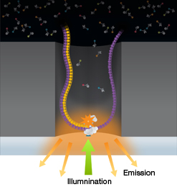
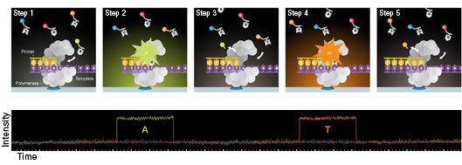
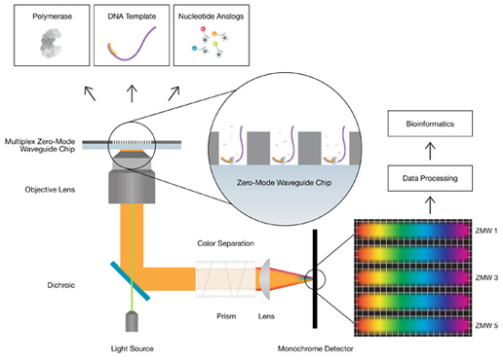
Other currently available sequencing
Pacific Biosciences: Zero-Mode Waveguide (ZMW) Sequencing
Advantages
Much longer read lengths (avg. ~10kb, max ~40kb)
Can detect modifications
Disadvantages
# of reads low (50k per run)
Higher error rate (> 10%)

Slide 15
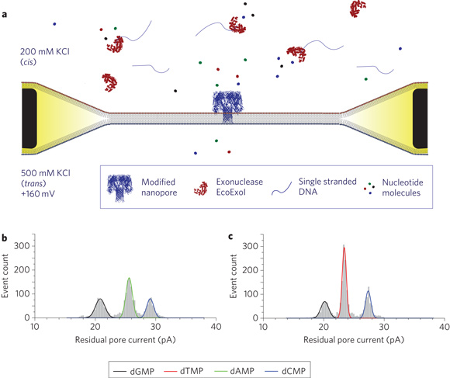
Other currently available sequencing
Oxford Nanopore: sequencing by exonuclease
Advantages
Even longer read lengths (avg. ~1kb, max ~100kb)
Cheaper at small scale
Disadvantages
# of reads low (depends on time, but in the tens of thousands)
Even higher error rate (> 30%)

Slide 16
Outline
Sequencing Technology overview
Which technology do I want for my task?
Overview of RNA-seq
General analysis concepts
Profiling gene expression and alternative splicing
Other uses of high-throughput sequencing
CLIP/RIP-seq: identifying protein binding sites
Ribosome profiling: quantification of translation
Others (RNA modifications, structure)
Public resources & large-scale data resources

Slide 17
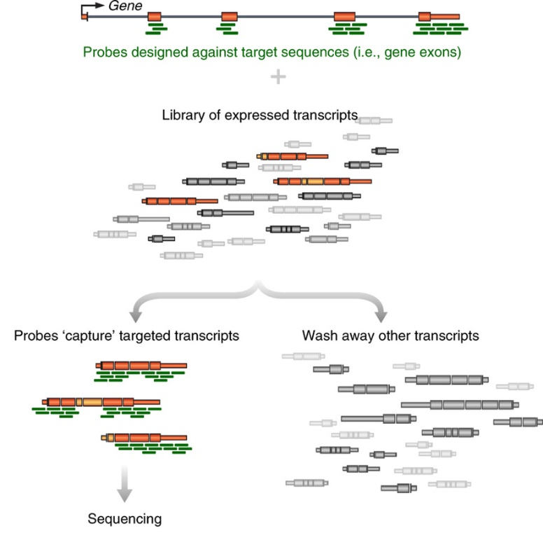
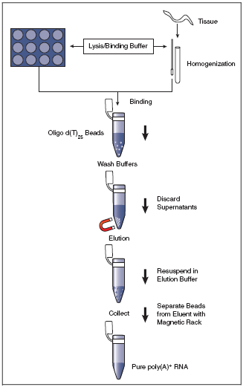
Generating RNA-seq libraries
Step 1: What RNA do you want to profile?
mRNA only -> PolyA selection
Specific RNAs -> targeted enrichment
(All mRNAs are polyadenylated at the 3’ end – can use d(T)₂₅ beads to select)

Slide 18
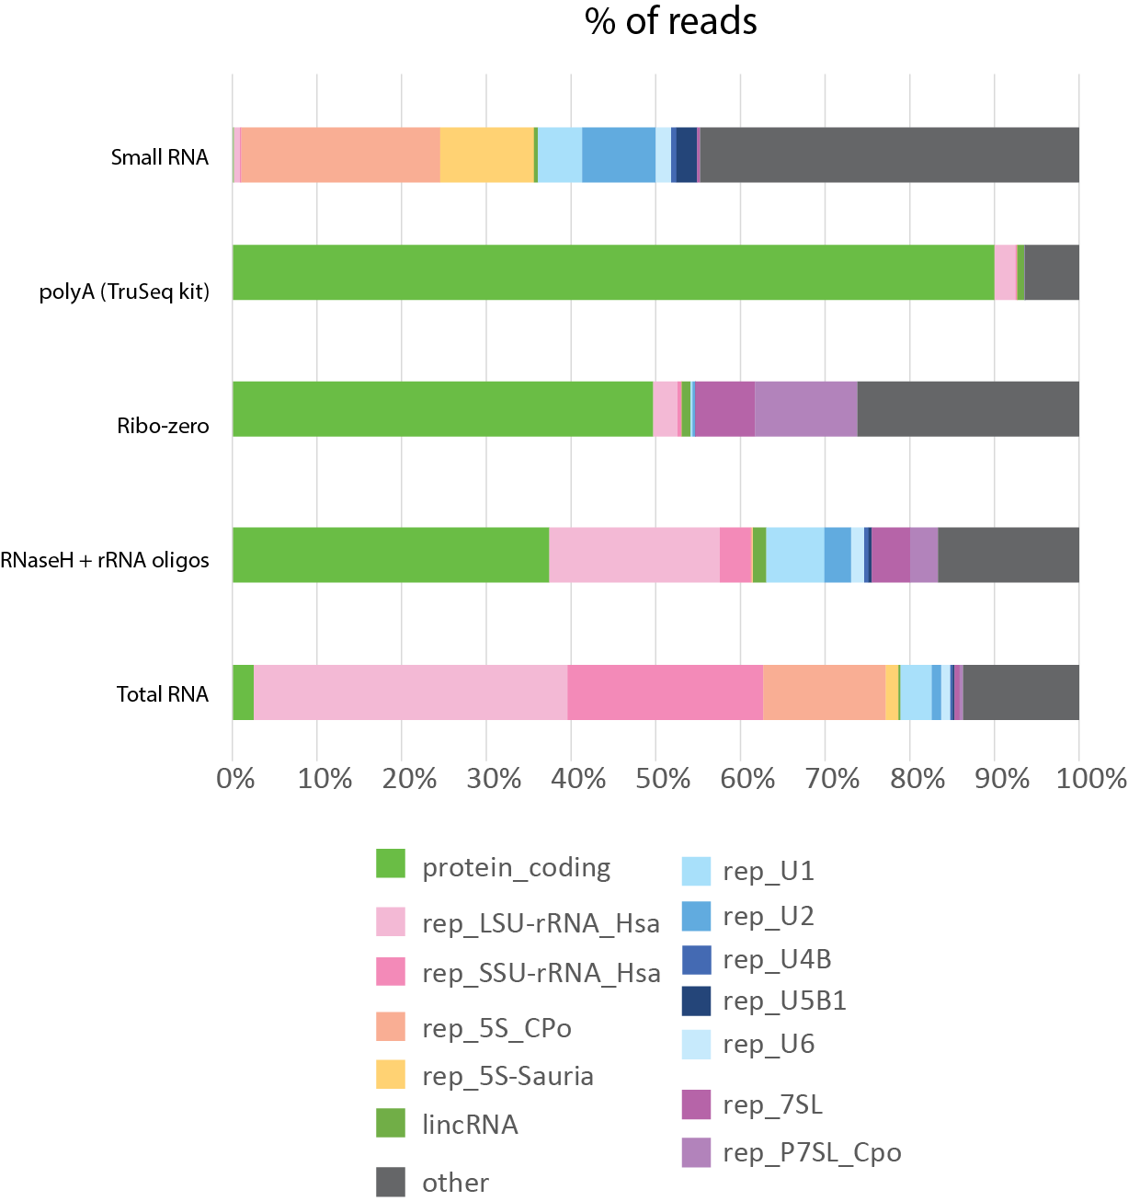
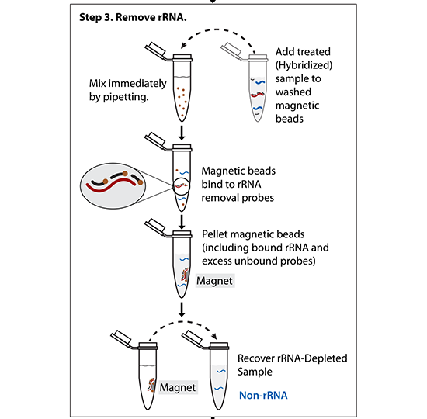
Step 1: What RNA do you want to profile?
Total RNA -> ribosomal RNA depletion
(Ribo-zero)
(Other methods – hybridize targeted DNA oligos + RNAseH treat)

Slide 19
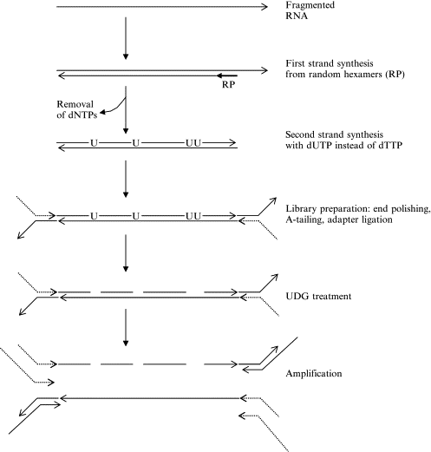
Generating RNA-seq libraries
Step 2: Converting RNA fragments into DNA fragments with proper adapters

Slide 20
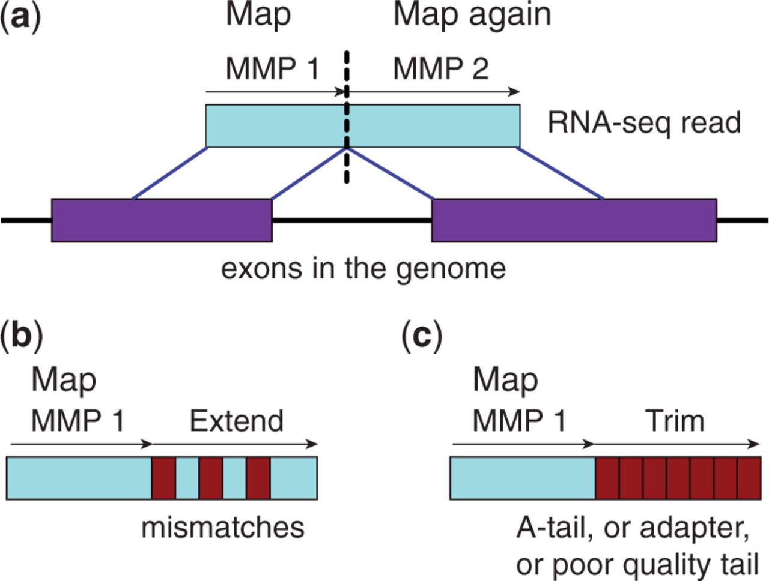
Analyzing RNA-seq libraries
Step 3: Sequence!
Step 4: Map reads to genome
STAR: Dobin, et al. (2012)
Read 1:
@M01356:152:000000000-ADTJC:1:1101:18461:2041 1:N:0:1
CCCTTGCATGGTGAGTGTTTTATGATTAAATATAGTTGGACTATTGGTTTCAACATGAGACTAATCCAGGGAGGTGACATGCC+
EEEFGGGHHGHFGFGFGGHHHHGHFGGFGFHBGHGAGHHBGHFFHHHFCHHHGGGGGFHFHHGGHFHGGHGEEGGHHHFHHHH
Read 2:
@M01356:152:000000000-ADTJC:1:1101:18461:2041 2:N:0:1
ATCCCAGCACACCCAGGTAGAAATGGTCGAGGAGT
+
??A00B100GF0BACF01DBB2E111D2/EEEA/0

Slide 21
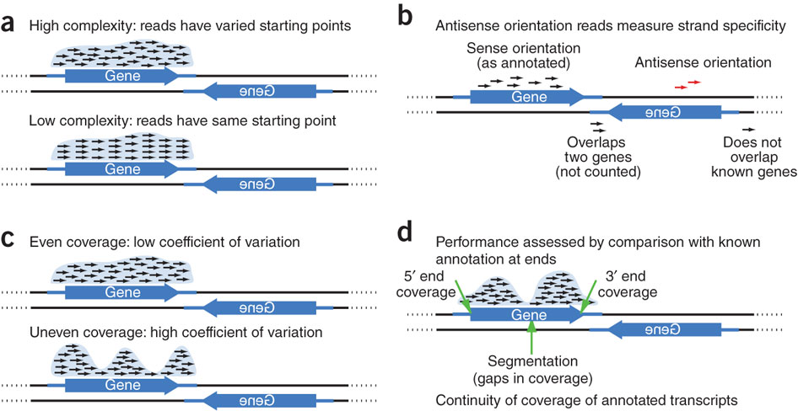
Considering RNA-seq quality

Slide 22
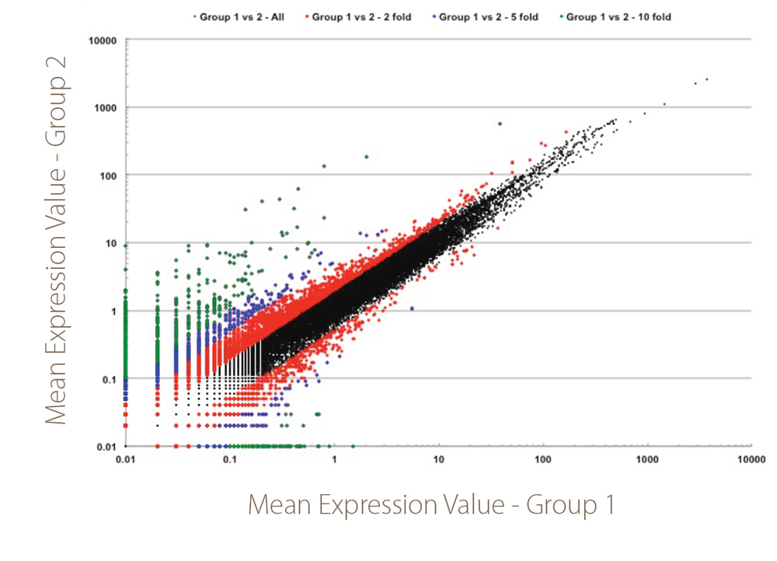
DESeq2 – quantitative analysis of RNA-seq data to identify differential expressed genes

Slide 23
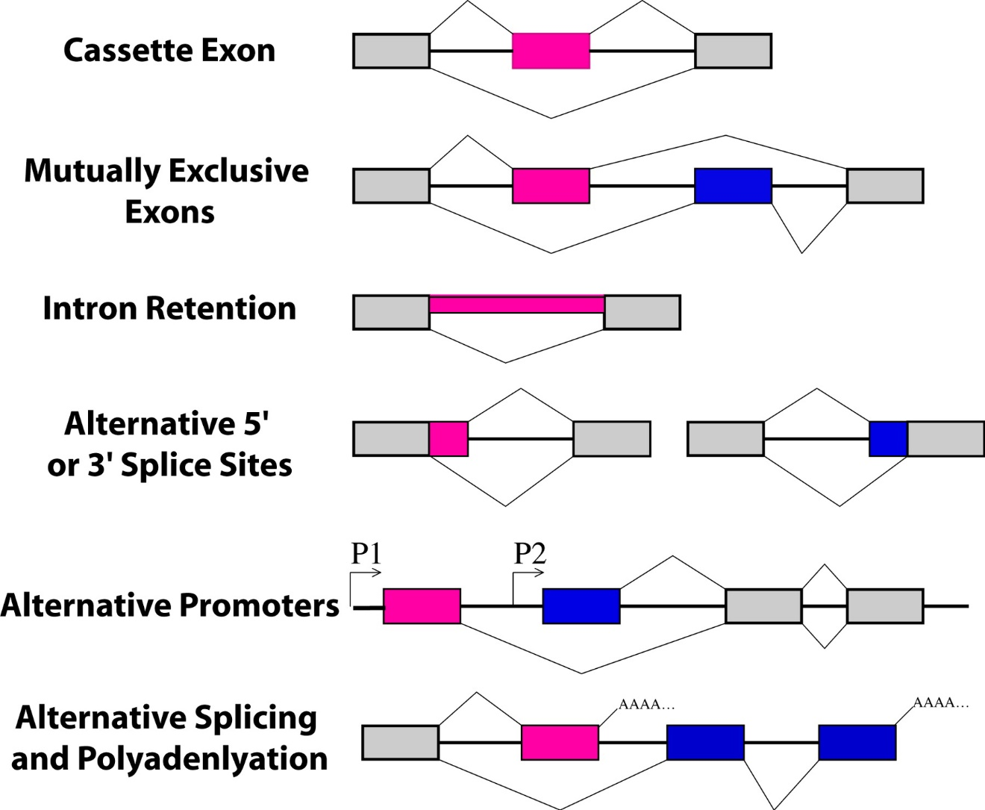
Alternative splicing generates multiple mRNAs and proteins from one protein-encoding gene

Slide 24
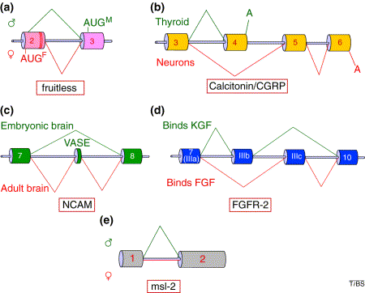
Alternative splicing generates multiple mRNAs and proteins from one protein-encoding gene
a) Alternative 5`ss usage:
sexual orientation and behavior in
Drosophila
b) Alternative 3`ss usage (and differential polyadenylation) in vertebrate calcitonin: calcium homeostatic hormone in thyroid or vasodilator neuropeptide in NS
c) Skipped exon in NCAM:
represses/enhances axon
outgrowth in development
d) Mutually exclusive exons: mammalian FGFR-2 changes
growth factor specificity during prostate cancer
e) Intron retention: female-specific retention of the
msl-2 controls export of unspliced RNA to cytoplasm->
X-chromosome dosage compensation
Smith and Valcarcel, Trends in Biochemical Sciences, 2000

Slide 25
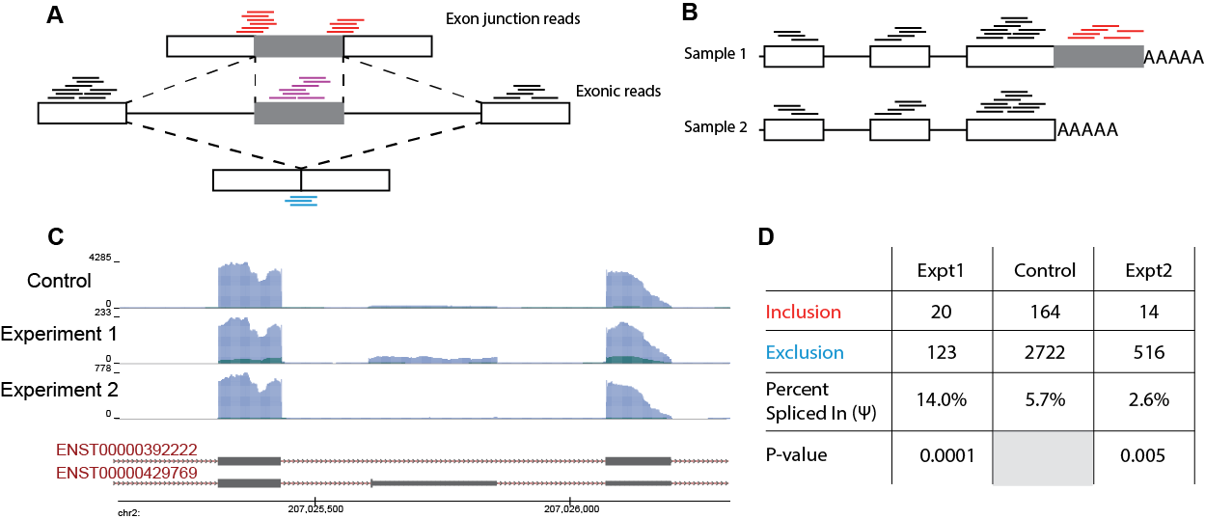
Quantification of alternative splicing
Basic quantitation – explicitly count inclusion and exclusion reads

Slide 26
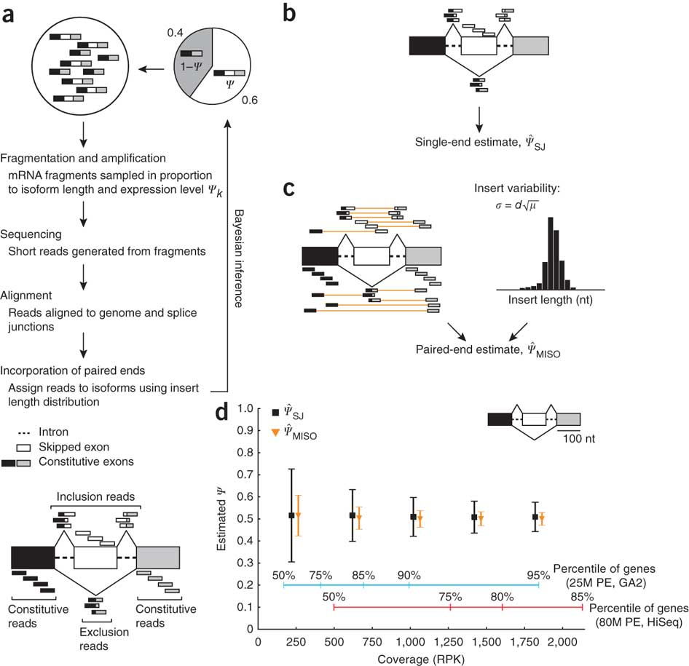
Quantification of alternative splicing
More complex: MISO (statistical modeling based on observed reads)
Katz et al. Nature Methods (2010)

Slide 27
Outline
Sequencing Technology overview
Which technology do I want for my task?
Overview of RNA-seq
General analysis concepts
Profiling gene expression and alternative splicing
Other uses of high-throughput sequencing
CLIP/RIP-seq: identifying protein binding sites
Ribosome profiling: quantification of translation
Others (RNA modifications, structure)
Public resources & large-scale data resources

Slide 28
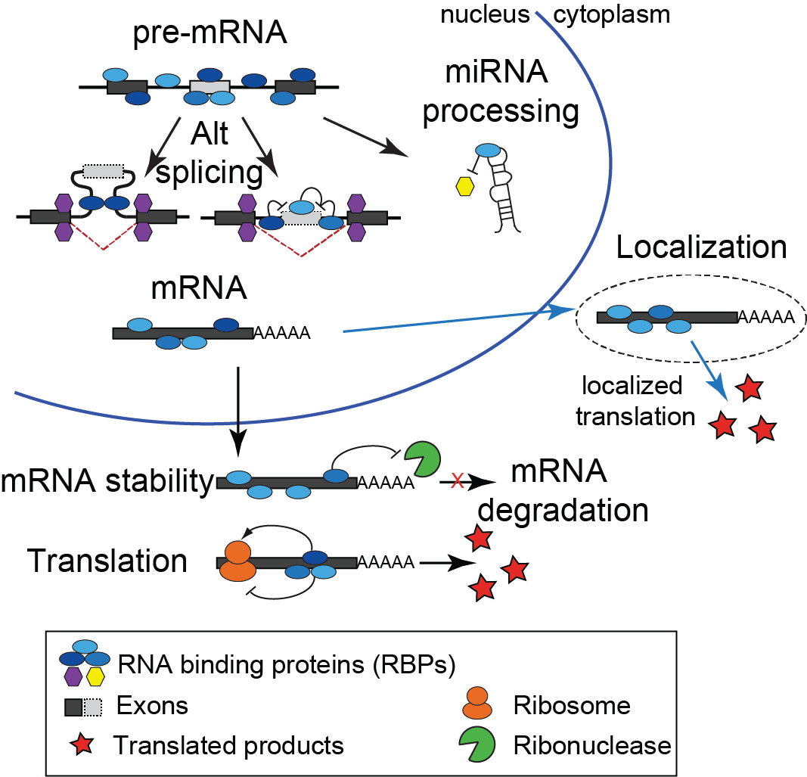
Each step of RNA processing is highly regulated
RNA binding proteins (RBPs) act as trans factors to regulate RNA processing steps
Estimated >1000 RBPs in human
RNA processing plays critical roles in development and human physiology
Mutation or alteration of RNA binding proteins plays critical roles in disease
Stephanie Huelga

Slide 29
Identifying RNA binding protein binding sites
RIP-seq (RNA Immunoprecipitation & high-throughput seq)
CLIP-seq (Cross-Linking Immunoprecipitation & high-throughput seq)
PAR-CLIP-seq (Photoactivatable ribonucleoside Cross-Linking Immunoprecipitation)

Slide 30
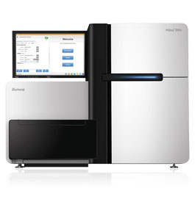
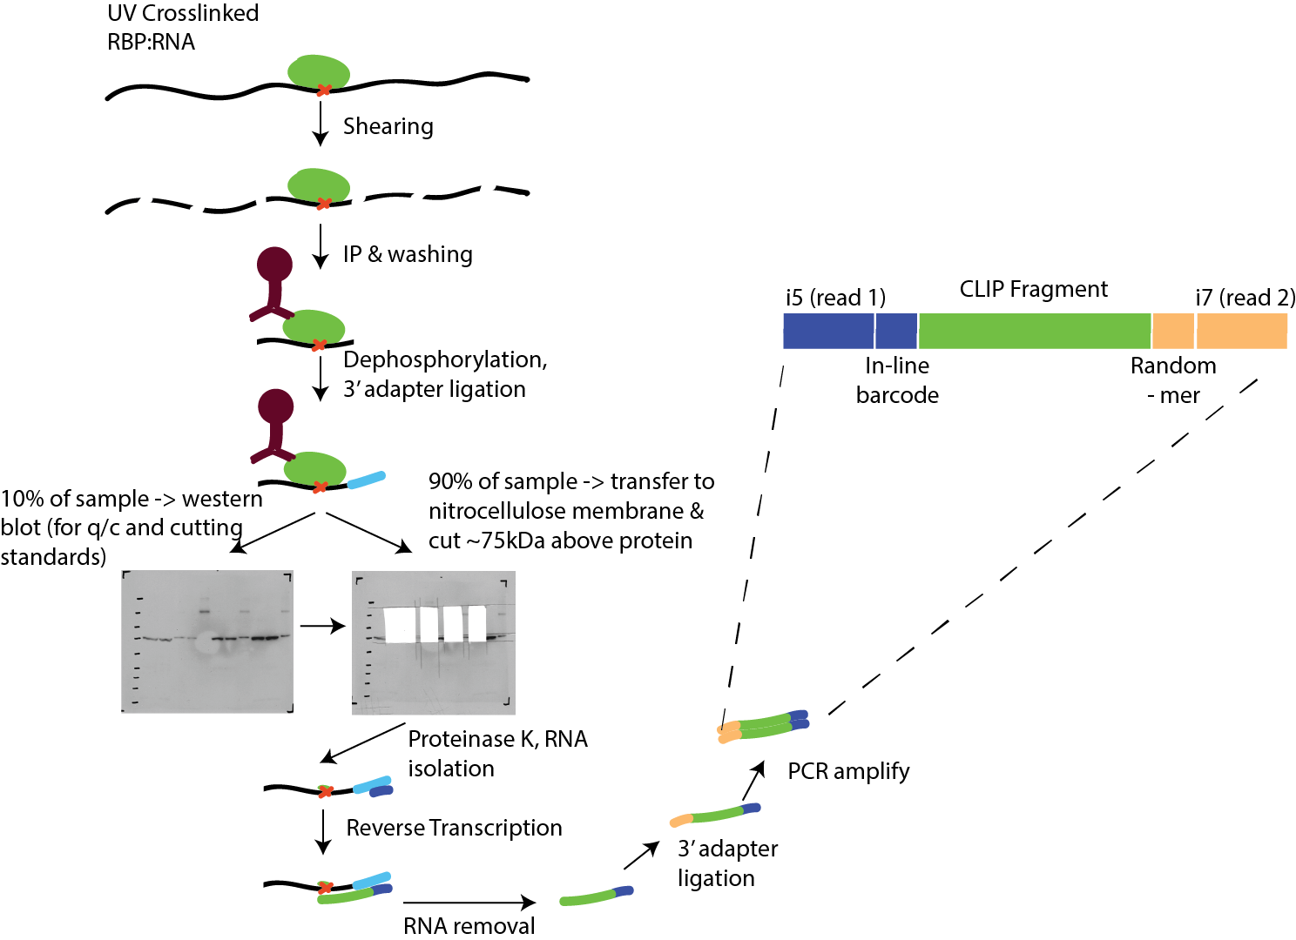
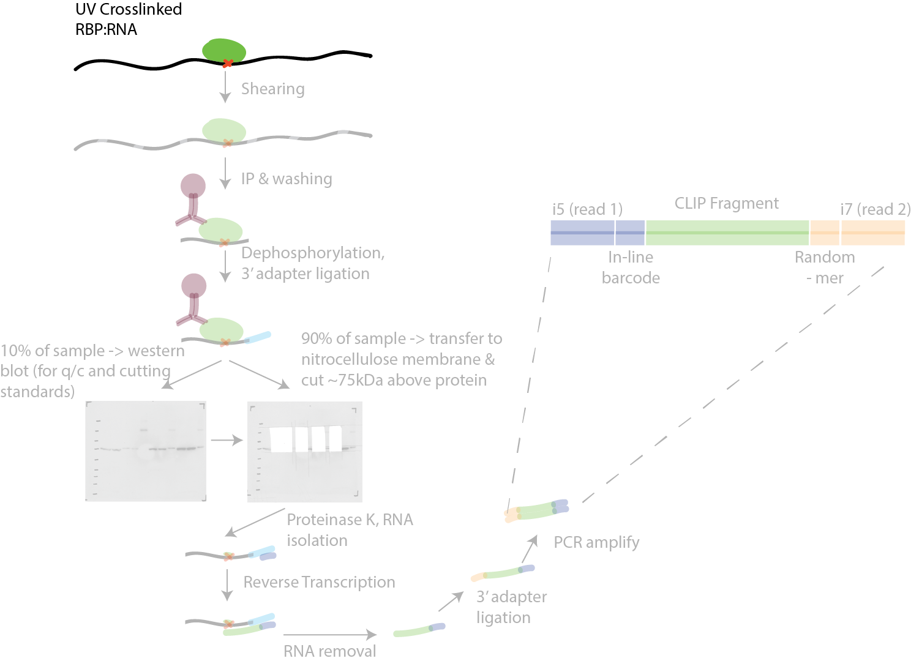
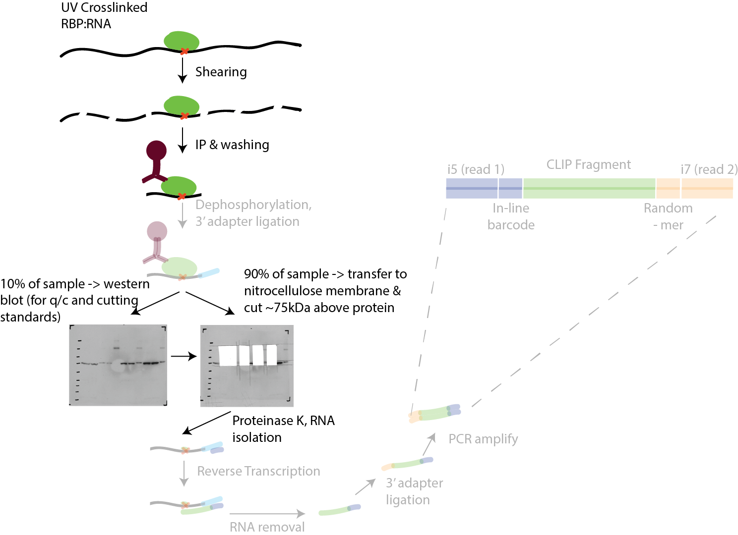
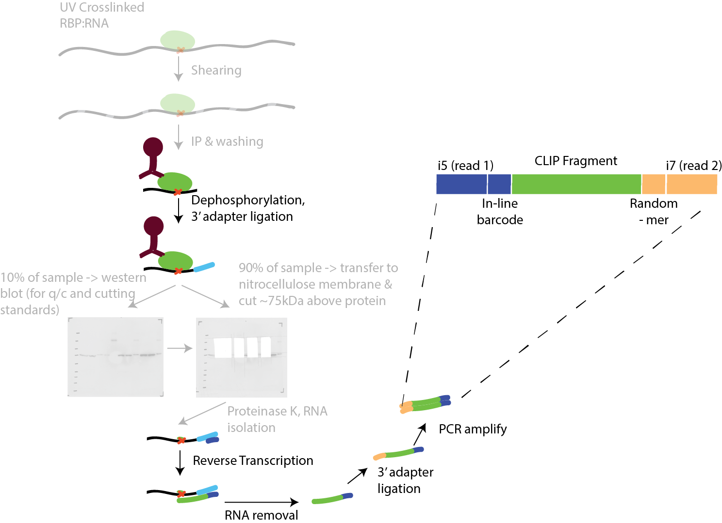
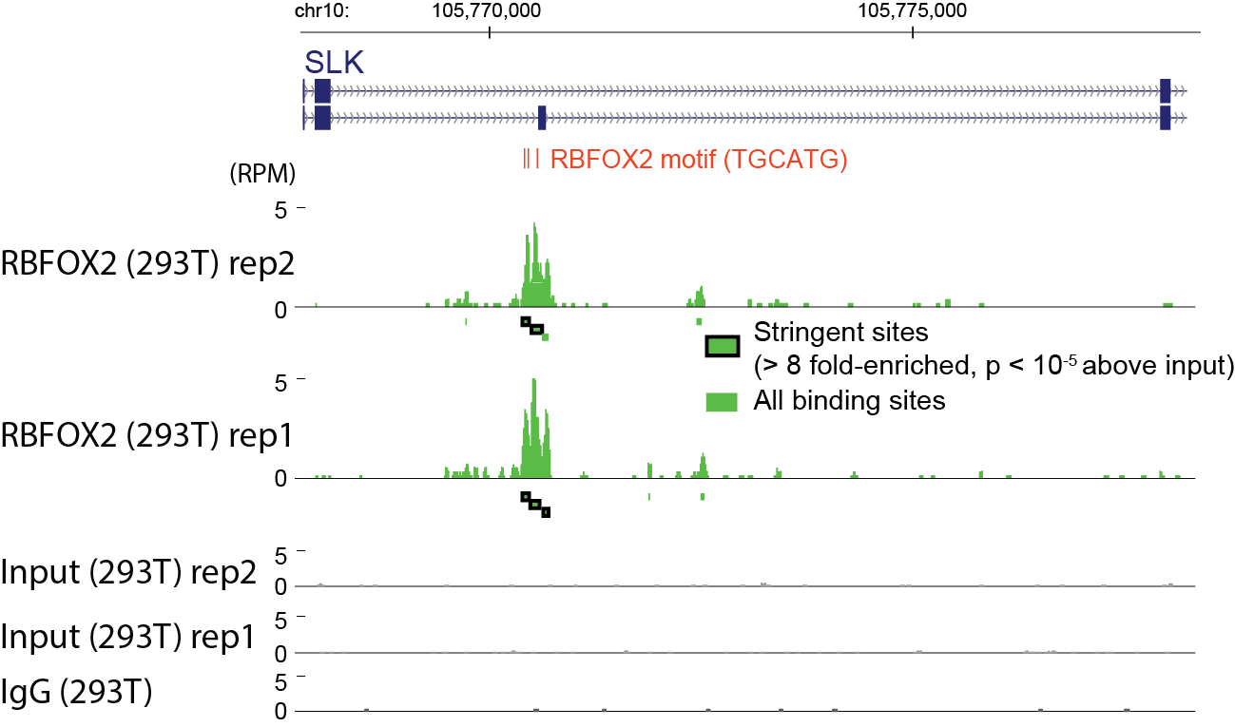
Identification of RNA binding protein targets by CLIP-seq
High-throughput sequencing
Data processing & peak calling

Slide 31
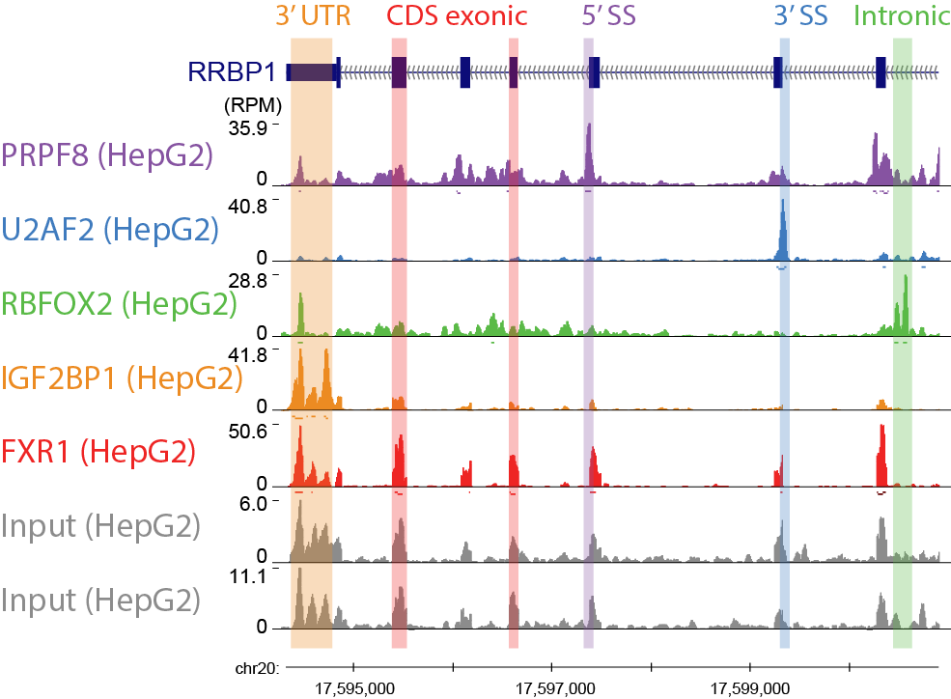
CLIP-seq reveals RBP-specific binding profiles

Slide 32
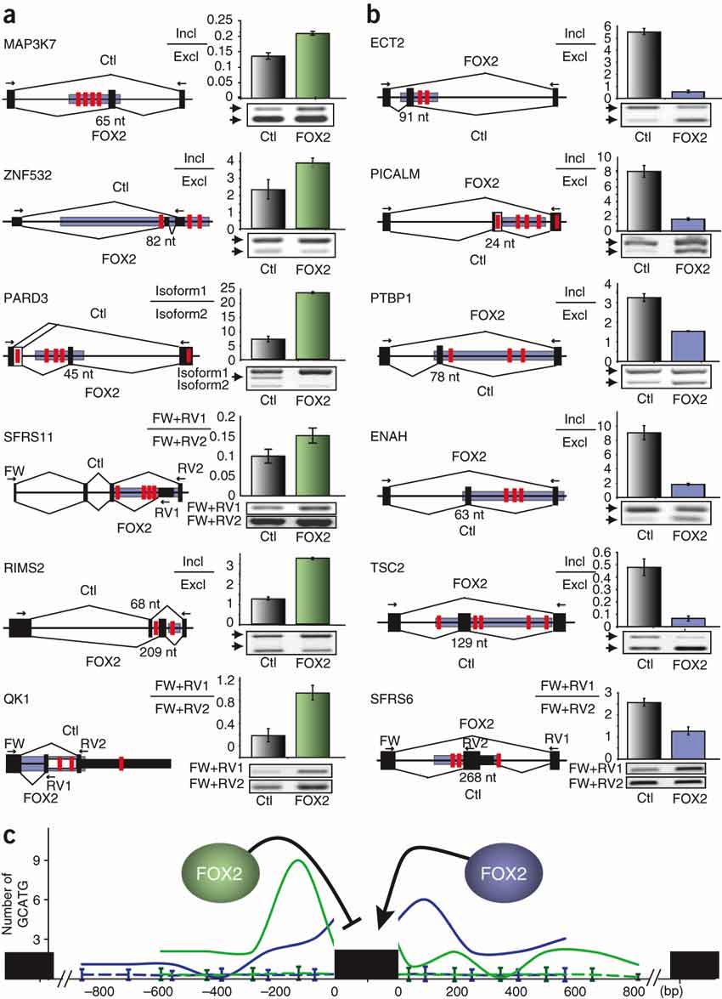
CLIP-seq enables building splicing regulatory maps

Slide 33
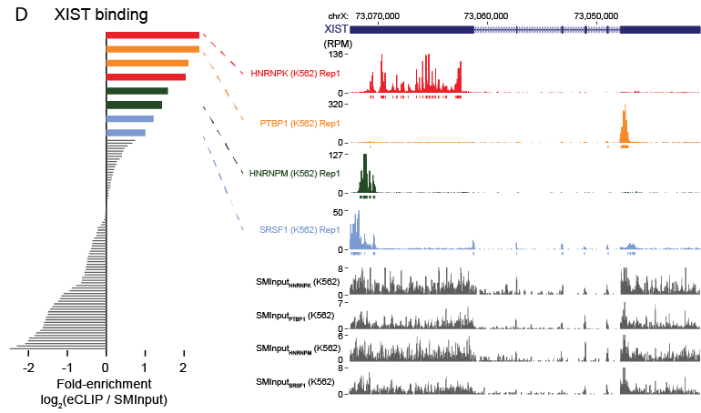
RNA-centric views from large-scale CLIP
152 ENCODE CLIP-seq datasets

Slide 34
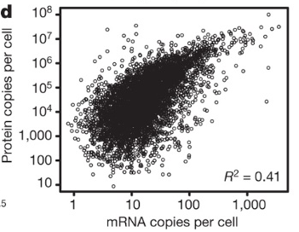
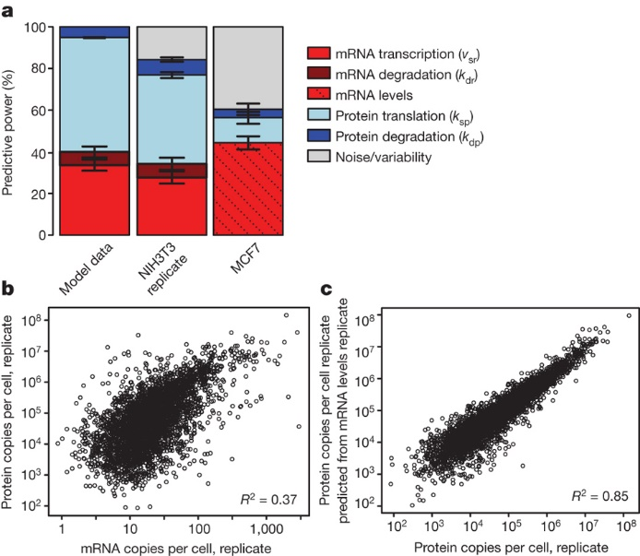
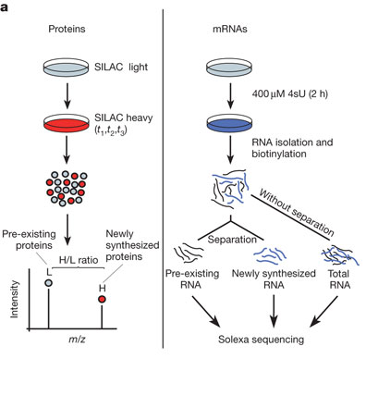
Going from RNA to protein quantification
Global quantification of mammalian gene expression control. Björn Schwanhäusser, et al. Nature 473, 337–342 (19 May 2011)

Slide 35
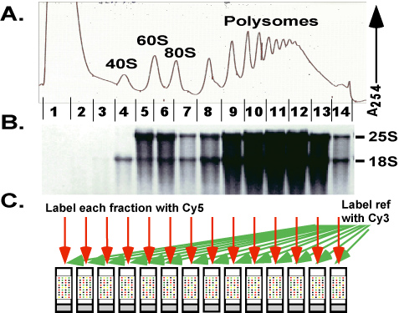
Ribosome profiling

Slide 36
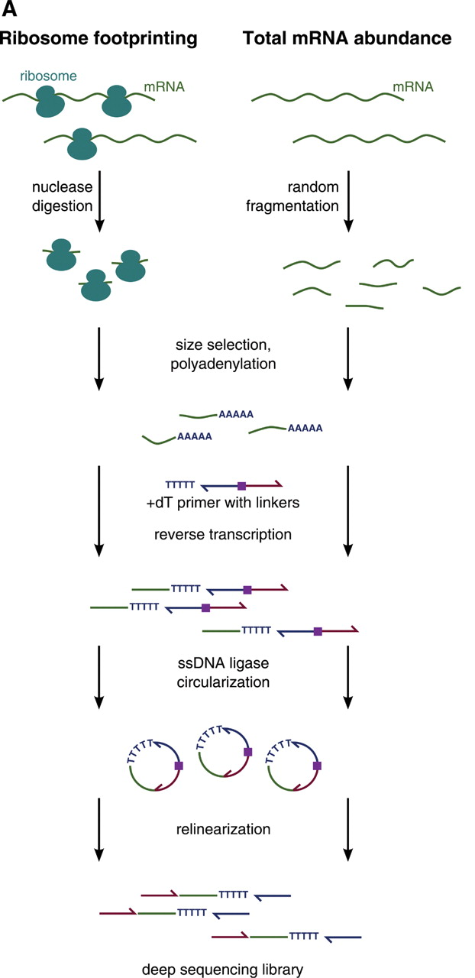
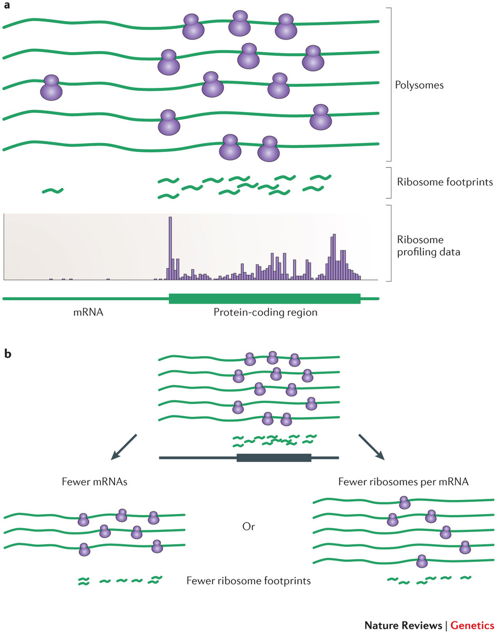
Ribosome profiling (Ribo-seq)
Ingolia, et al. Science (2009) & Ingolia, Nat. Rev. Genetics (2014)

Slide 37
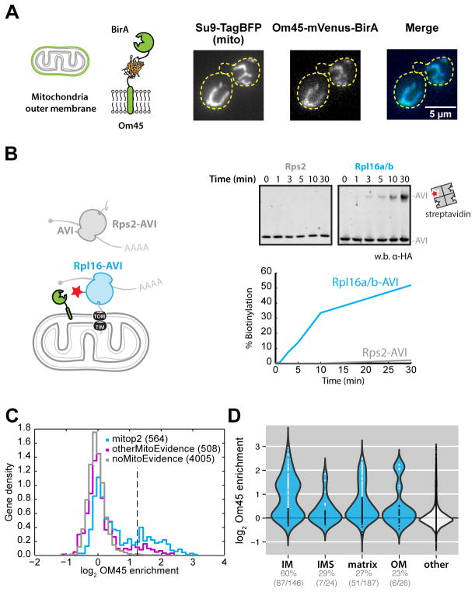
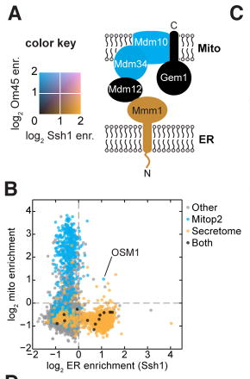
Localized translation profiling
Williams et al. Science (2014)

Slide 38
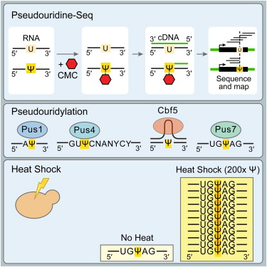
RNA modification profiling: Pseudouridine

Slide 39
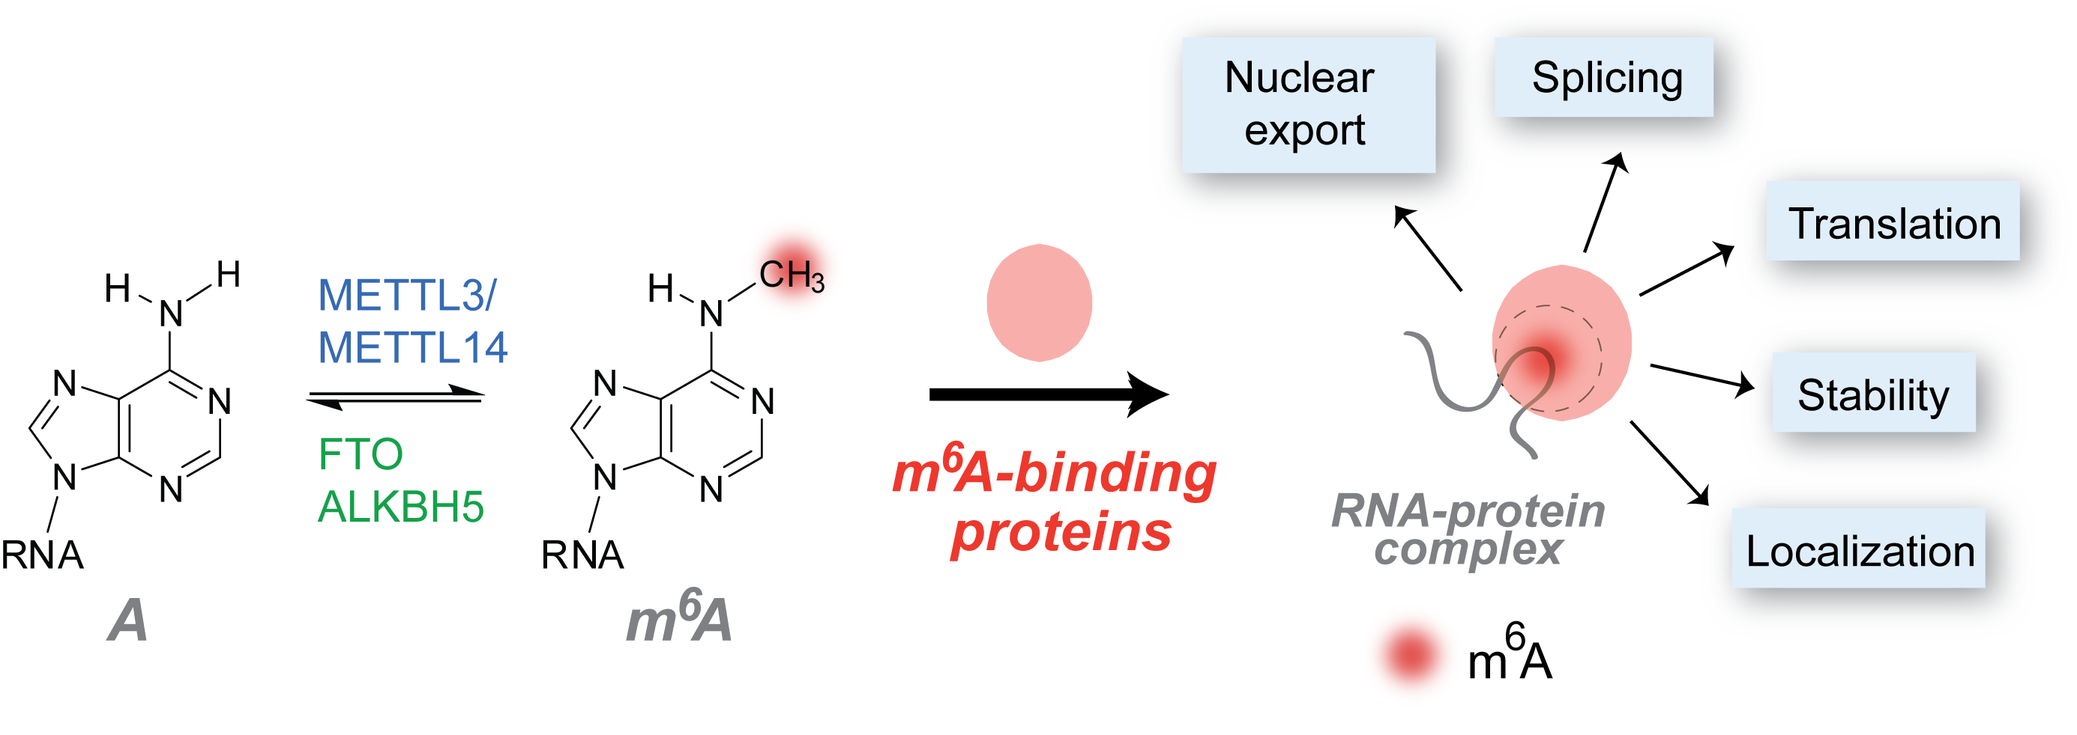
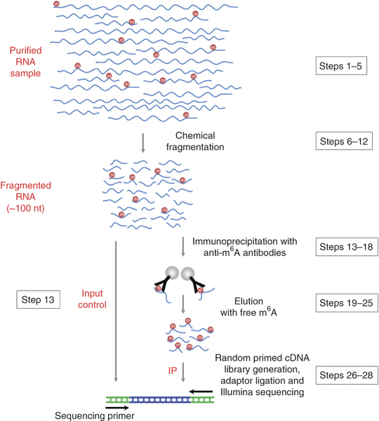

RNA modification profiling: M6A methylation
m⁶A-binding proteins

Slide 40
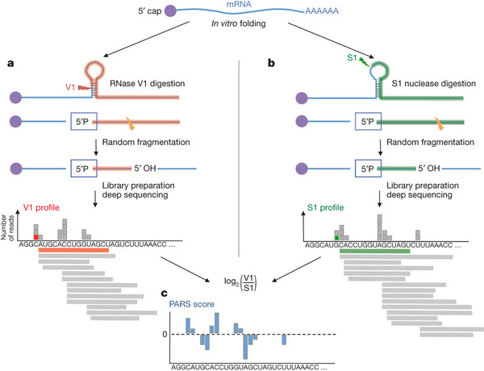
RNA structure profiling

Slide 41


Slide 42
Outline
Sequencing Technology overview
Which technology do I want for my task?
Overview of RNA-seq
General analysis concepts
Profiling gene expression and alternative splicing
Other uses of high-throughput sequencing
CLIP/RIP-seq: identifying protein binding sites
Ribosome profiling: quantification of translation
Others (RNA modifications, structure)
Public resources & large-scale data resources

Slide 43
General resources for getting LOTS of sequencing data
GEO (NCBI Gene Expression Omnibus) - http://www.ncbi.nlm.nih.gov/geo/ , SRA (Sequence Read Archive) - http://www.ncbi.nlm.nih.gov/sra , ENA (European Nucleotide Archive) - http://www.ebi.ac.uk/ena
NCBI & EMBL’s public databases for depositing published data
Searchable by ID (from papers) or by gene, tissue, experiment type, etc. to obtain many datasets for global analyses
dbGAP - http://www.ncbi.nlm.nih.gov/gap
Controlled-access version (for data with genotype/personally identifiable information)
Illumina Body Map - http://www.ebi.ac.uk/arrayexpress/experiments/E-MTAB-513/
Basic RNA-seq dataset of 16 human tissues

Slide 44

Gene expression & splicing resources
GTEx project - http://www.gtexportal.org/
Perform RNA-seq and genotyping for 43 tissues across hundreds of individuals
Pilot phase: 1641 RNA-seq datasets
Identification of eQTLs (SNPs that associate with expression)
The Genotype-Tissue Expression (GTEx) pilot analysis: Multitissue gene regulation in humans. Science (May 2015)

Slide 45

Gene expression & splicing resources
TGCA (The Cancer Genome Atlas) - http://cancergenome.nih.gov
RNA-seq, microarray, genome sequencing, other mutation assays for > 25 cancer types
In 2012, had 4747 samples with expression profiling

Slide 46

RNA processing regulation
ENCORE
K562 & HepG2 cells
ENCORE: ENCODE RNA regulation group - https://www.encodeproject.org
Goal: to characterize 250 RNA binding proteins in 2 cell lines with knockdown RNA-seq, CLIP-seq, & ChIP-seq
76 CLIP-seq and 307 RNA-seq datasets already deposited
Yeo
Fu
Burge
Graveley

